Slide 1
How to Build Wikitheoria Recommender System
Research Discussion
Mingzhe Du
04/19/2016

Slide 2
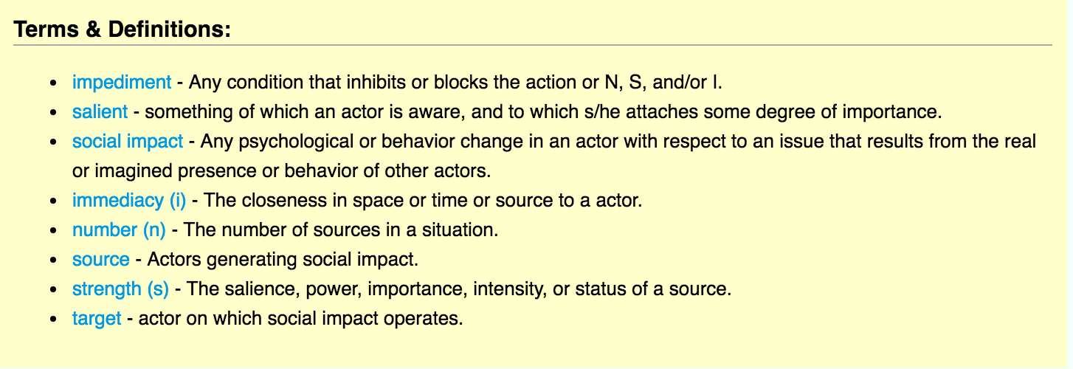
Scenario

Slide 3
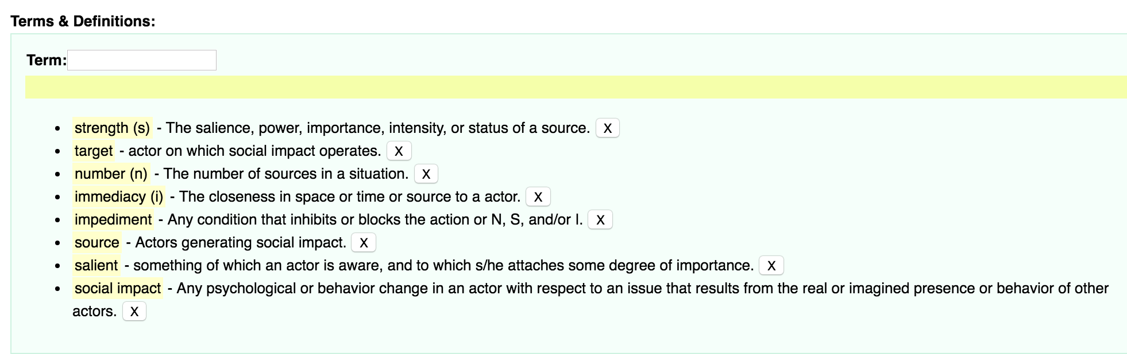
Scenario

Slide 4
Recommender Workflow
Query Understand
Lexicon
Select Terms
Filter Terms
Rank Terms
Select Top K
Append
Recommended Terms

Slide 5
Rank Score
Rank Score = 0.25 * Relevance Score + 0.75 * Semantic Score

Slide 6
Query Understand with NLP
Query Clean: remove stop words like “a”, “the” ..
Stemming: “boy’s toy car” -> “boy toy car”
Tokenize: [“boy”, “toy”, “car”]
Query Rewrite: “boy car”, “toy car”, “boy toy”
Relevance Calculate

Slide 7
Relevance Score
Forward Index: key, term, definitions
Build Inverted Index based on Forward Index
Relevance Score = number of word match query / total number of words in key words
Num of match → Inverted Index

Slide 8
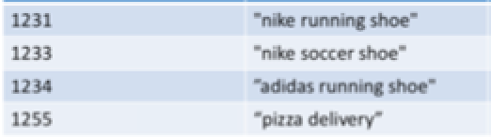
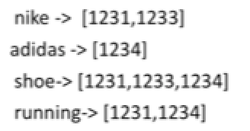
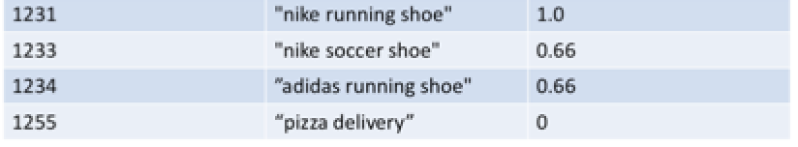
Relevance Score
Example: Search “Nike Running Shoe”

Slide 9
Semantic Score
Find Close Terms through Semantic Analysis
Solutions with Deep Learning: (Under Investigation)
Convolutional Neural Network
With Back-propagation
Convolutional Neural Network
No Prior Knowledge Required (Yann LeCun)
Recurrent Neural Network
With Long Short Term Memory (LSTM)
Topic Model / Language Model

Slide 10
Computation
Google TensorFlow
Amazon EC2

